Slide 1
Modeling and Simulation

Slide 2
Modeling and Simulation – Learning Objectives
How to build a model
Monte Carlo simulations
Solving differential equations numerically

Slide 3
Monte Carlo Simulations
A broad class of computational algorithms that rely on repeated random sampling to obtain numerical results.
Optimization
Numerical integration
Sampling probability distributions
A broad class of computational algorithms that rely on repeated random sampling to obtain numerical results.
Optimization
Numerical integration
Sampling probability distributions

Slide 4
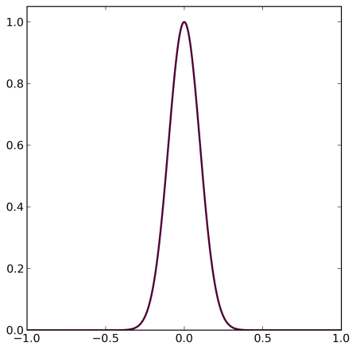
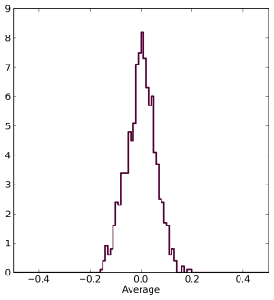
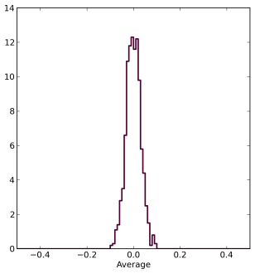
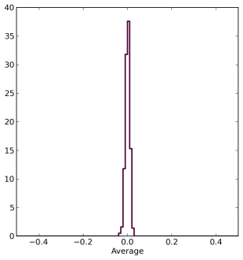
A Tool for Learning Statistics: Standard Error
  Normal Distribution
  n=3
  n=10
  n=100
Standard Error
of the Mean
Mean
Mean
Mean

Slide 5
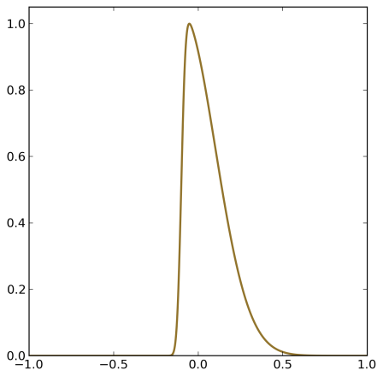
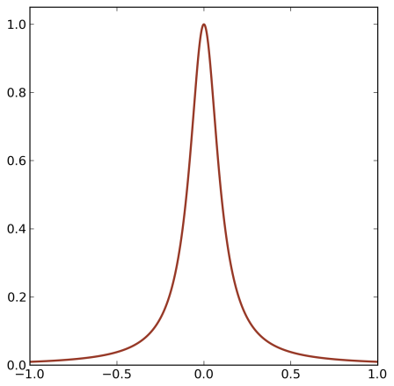
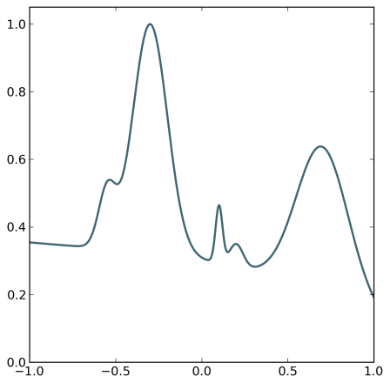
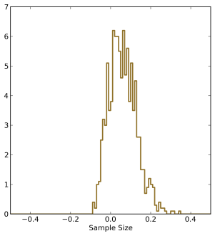
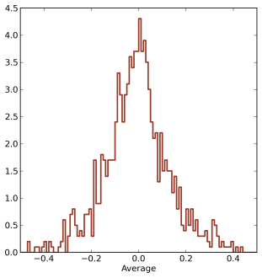
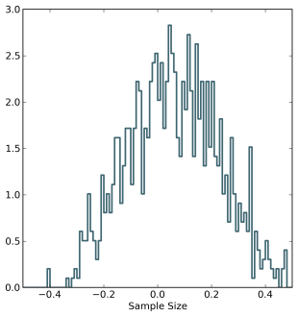
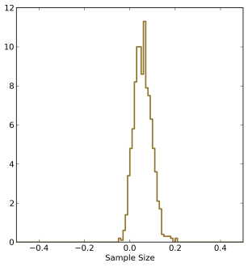
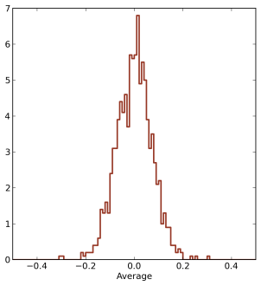
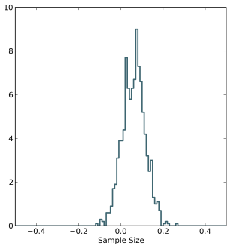
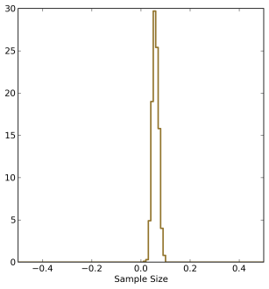
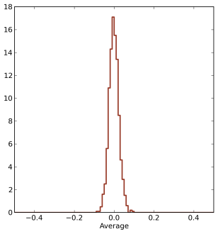
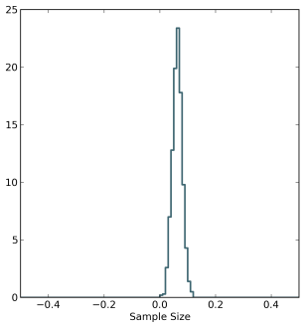
A Tool for Learning Statistics: Central Limit Theorem
  Normal
  Skewed
  Long tails
  Complex
  n=3
  n=3
  n=3
  n=10
  n=10
  n=10
  n=10
  n=100
  n=100
  n=100
  n=100
  n=1000
Mean
Mean
Mean
Mean

Slide 6
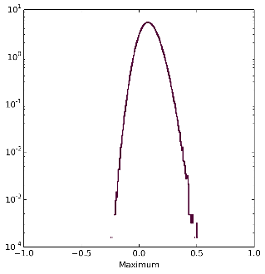
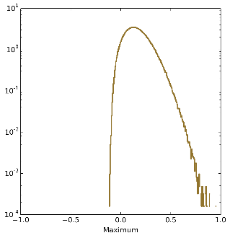
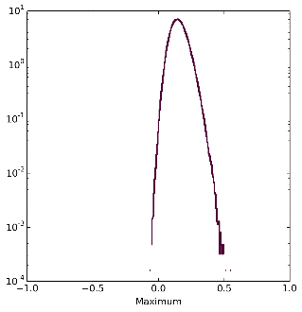
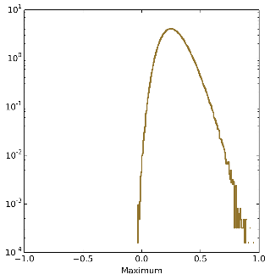
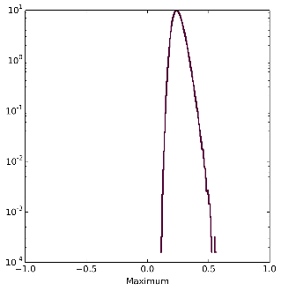
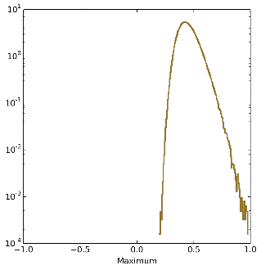
A Tool for Learning Statistics: Extreme Value Distributions
  Normal
  Skewed
  n=3
  n=3
  n=10
  n=10
  n=100
  n=100
Max
Max

Slide 7
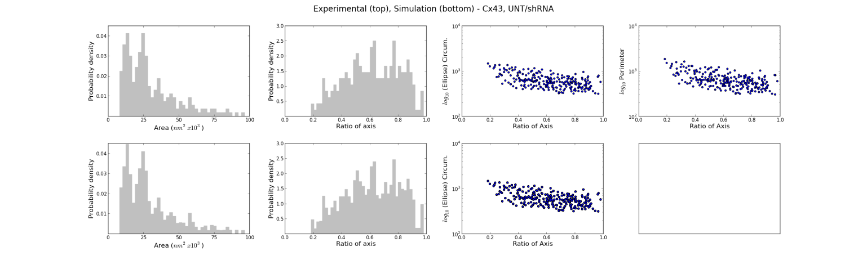
Randomly Sample from Distributions
Generate a pair of random numbers within the range.
Assign them to x and y
Keep x if the point (x,y) is within the distribution.
Repeat 1-3 until the desired sample size is obtained.
The values x obtained in this was will be distributed according to the original distribution.

Slide 8
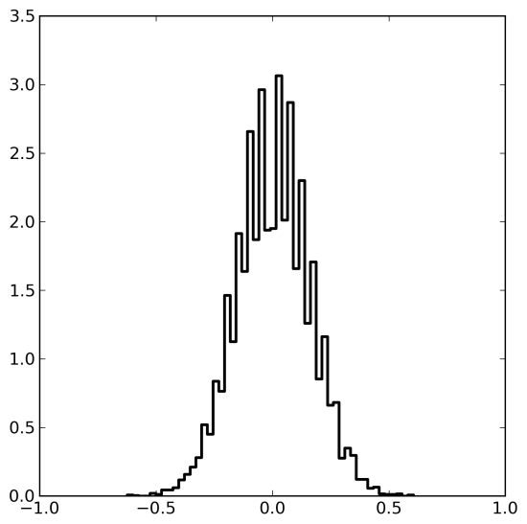
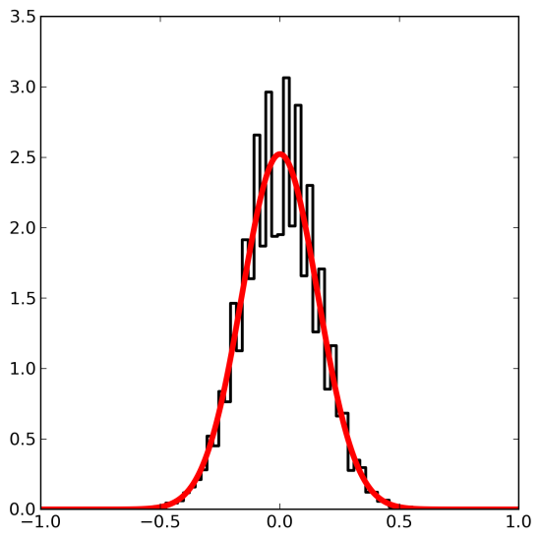
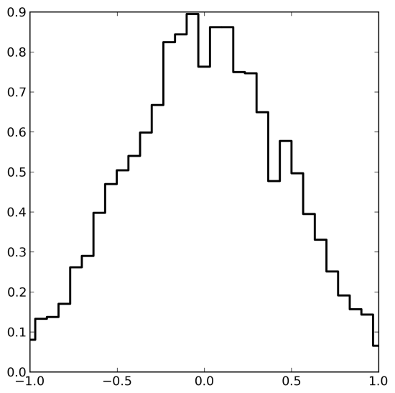
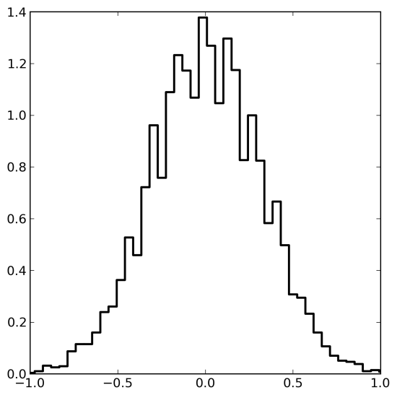
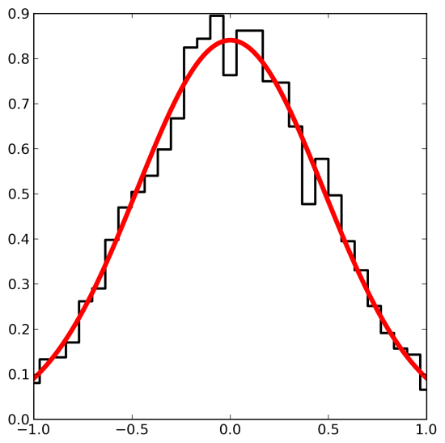
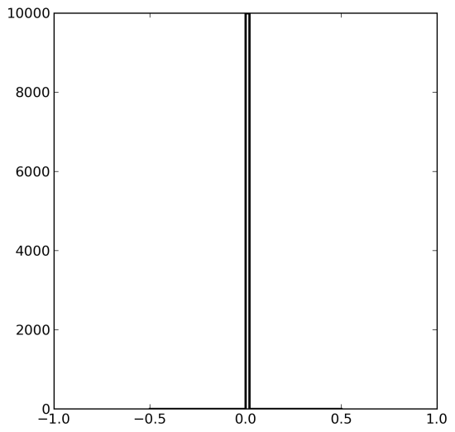
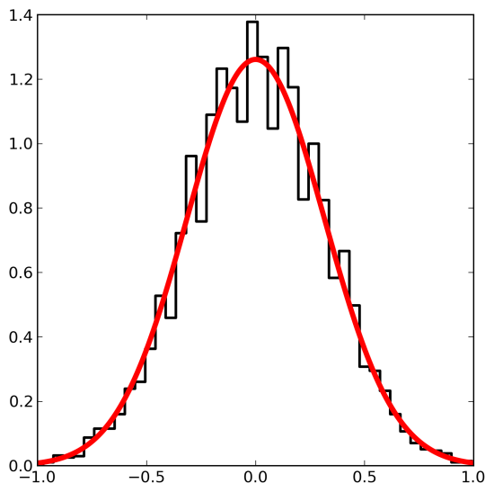
Diffusion
Diffusion can be simulated using a random walk.
  t=0
  t=1
  t=4
  t=9
Position
Position
Position
Position

Slide 9
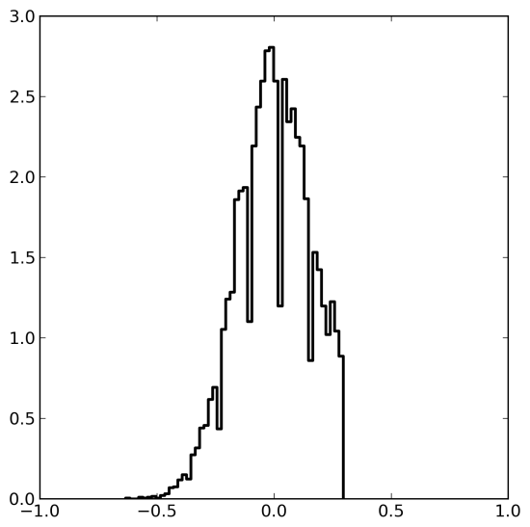
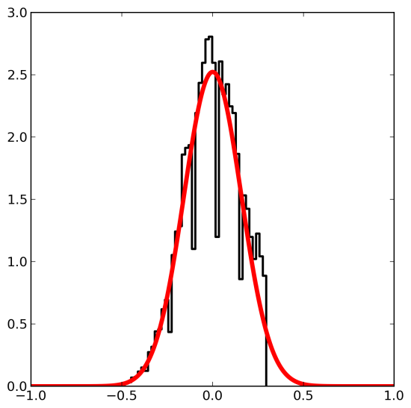
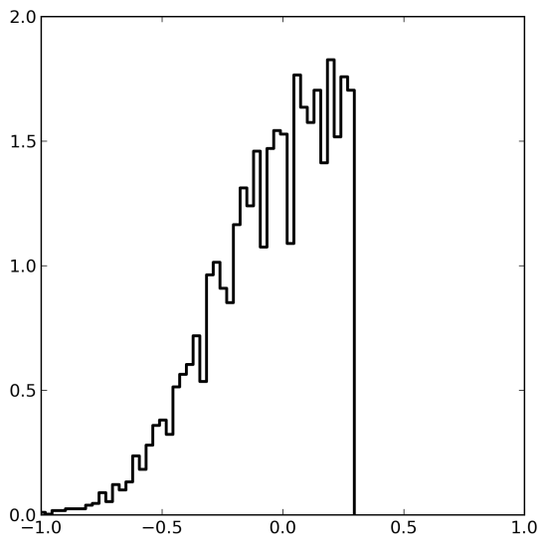
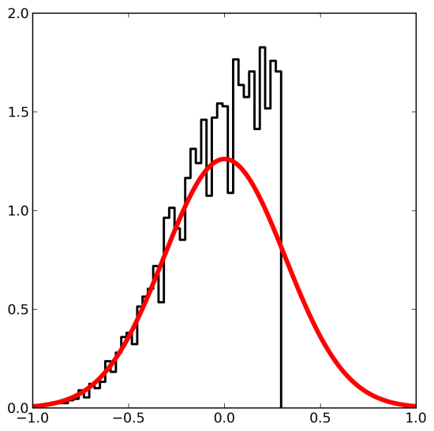
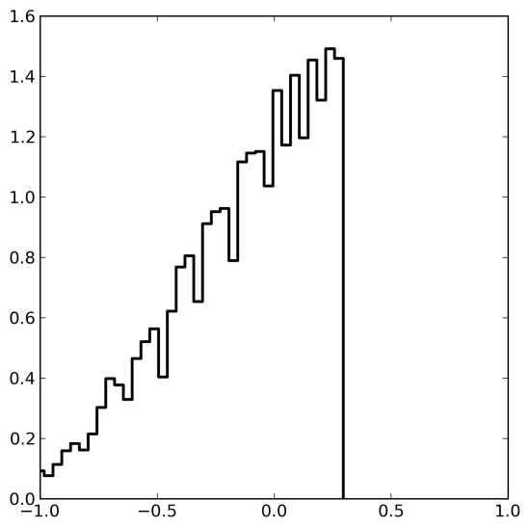
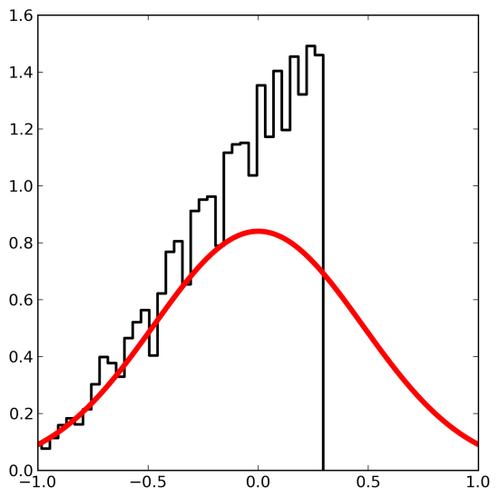
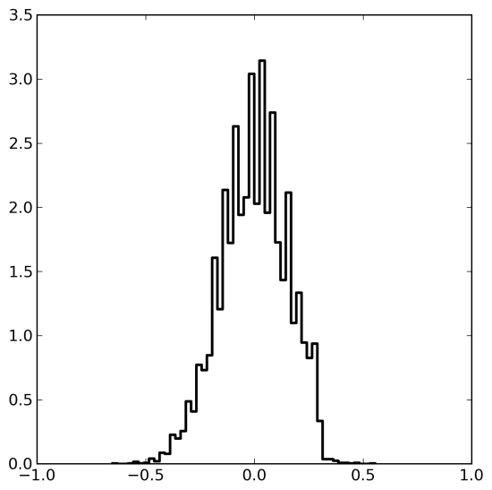
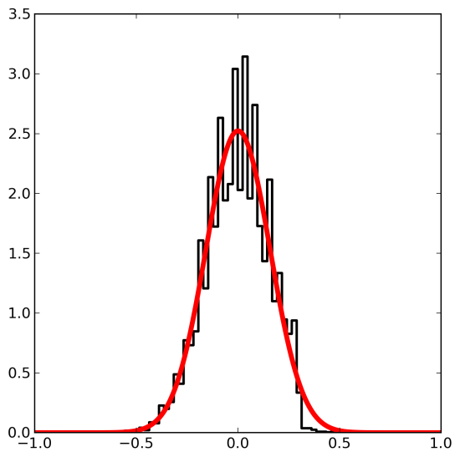
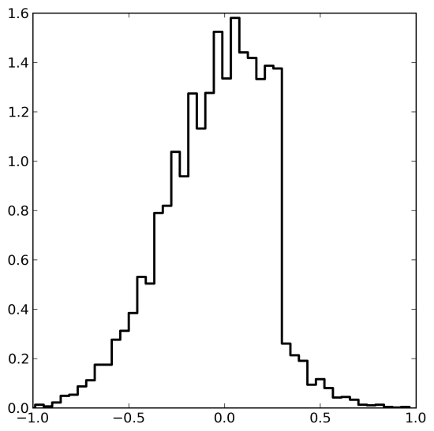
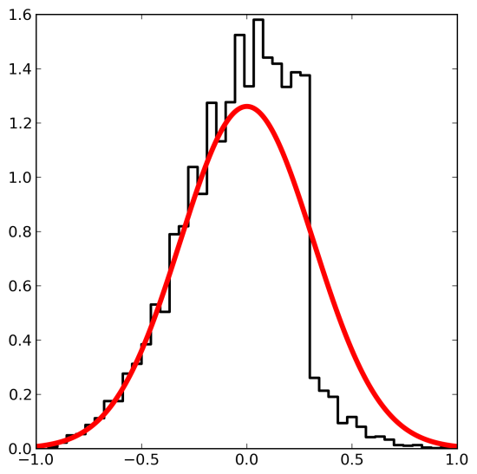
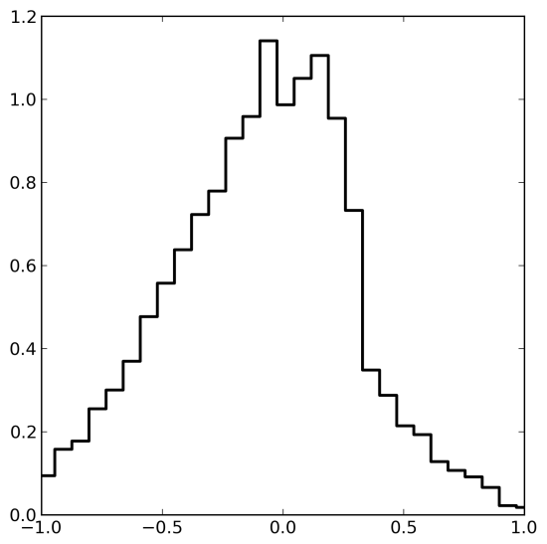
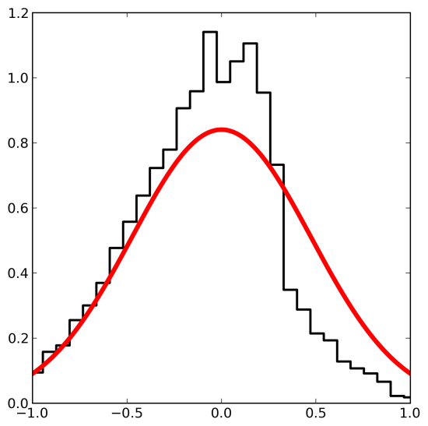
Diffusion at a Wall
Solid Wall
  t=1
  t=4
  t=9
  t=0
Position
Position
Position
Porous Wall
  t=1
  t=4
  t=9
Position
Position
Position
Position

Slide 10
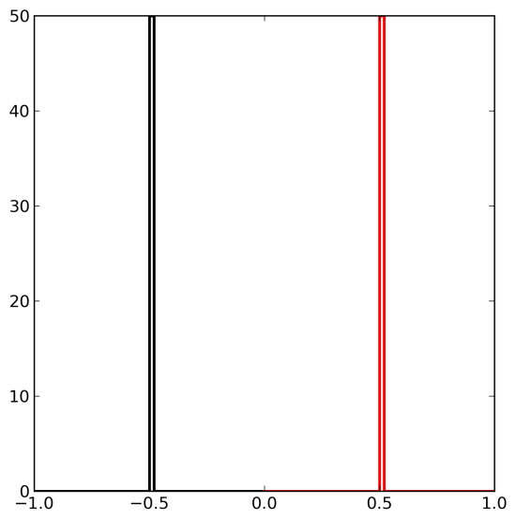
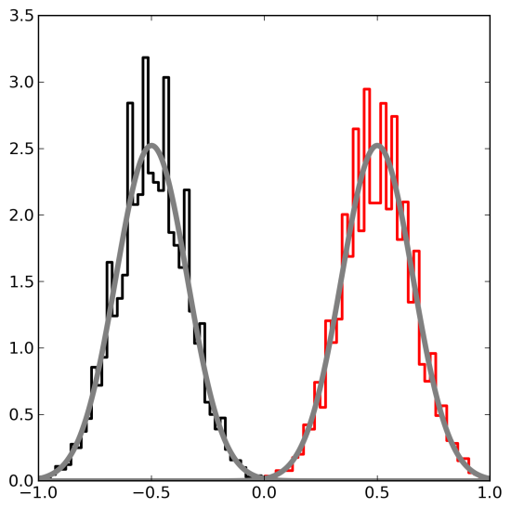
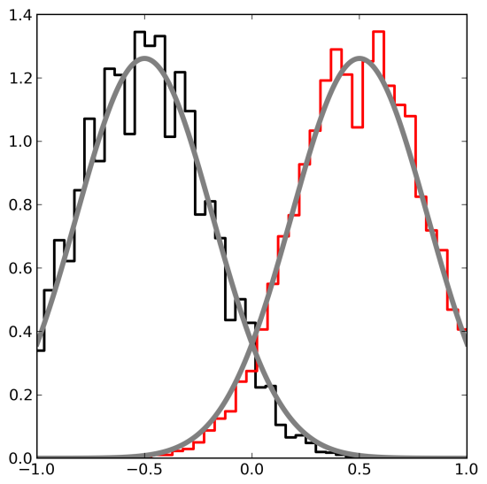
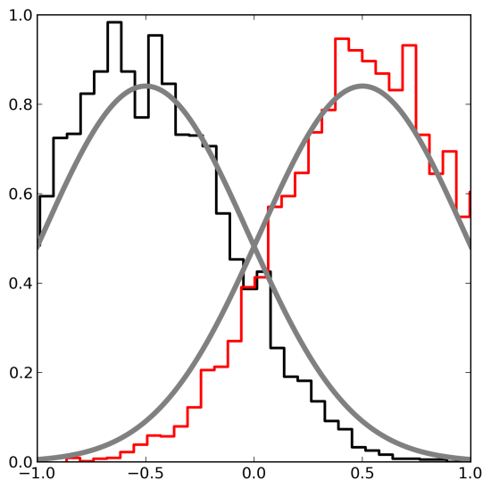
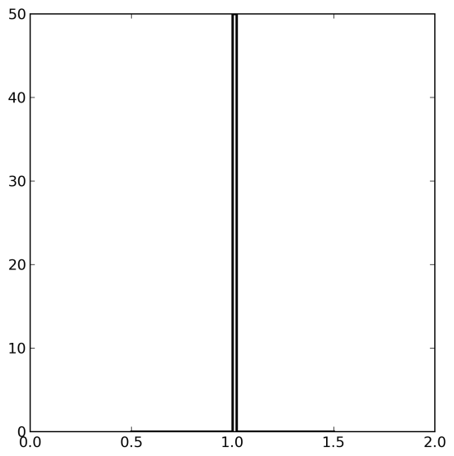
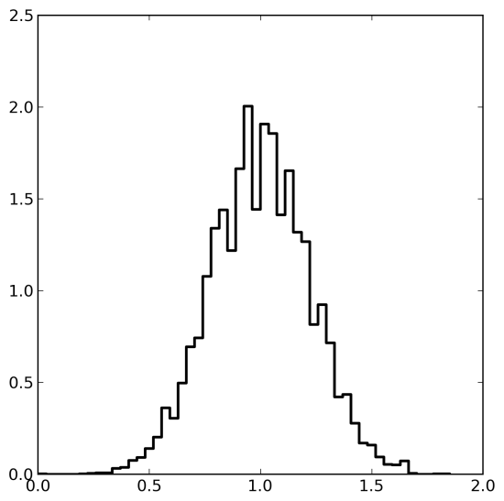
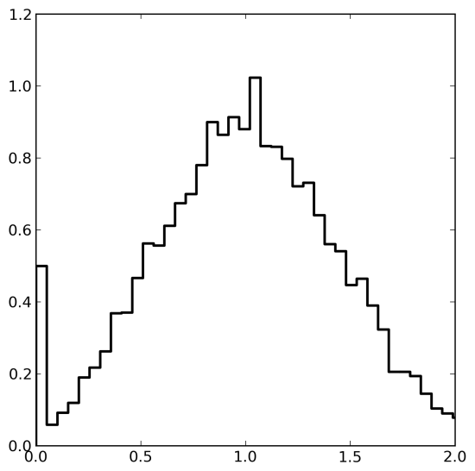
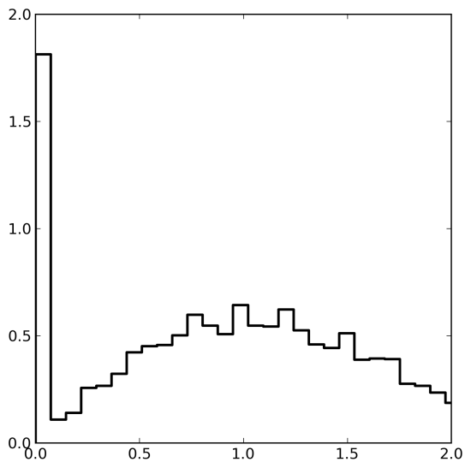
Diffusion - Collisions
  t=0
  t=1
  t=4
  t=9
Position
Position
Position
Position
Distance
Distance
Distance
Distance

Slide 11


Diffusion - Collisions
1.0
1D
Collision Probability
0.5
0
0
500
1000
Time
1.0
2D
Collision Probability
0.5
0
0
500
1000
Time

Slide 12
Agent Based Models
The diffusion simulations were simple examples of agent based models: the agents walked at random until they collided.
Flocking:
  Separation - avoid getting too close to neighbors
  Alignment – fly in the direction of neighbors
  Cohesion – avoid too far from nearest neighbors
  Only information about nearest neighbors is used.
Understanding evolution using game theory. How can cooperation arise in a game where exploitation is the best strategy in each individual interaction (Prisoner’s Dilemma)?

Slide 13

Differential Equations - Growth
Exact Solution
Numerical Solution
Population Size - N(t)
Time - t

Slide 14

Growth – Limited Resources
The maximum population supported is N_{max}
Exact Solution
Numerical Solution
Population Size - N(t)
Time - t

Slide 15


Predators and Prey
where k_{b} is the birth rate of the prey, k_{d} is the death rate of the predators, k_{s} is the search efficiency, and k_{e} is the efficiency with which food is converted into predators.
Prey
Population Size - N(t)
Prey
Predators
Time - t
Predators

Slide 16


Predators and Prey
Prey
Population Size - N(t)
Prey
Predators
Time - t
Predators
Prey
Population Size - N(t)
Prey
Predators
Time - t
Predators

Slide 17


Predators and Prey - Limited Resources
where k_{b} is the birth rate of the prey, k_{d} is the death rate of the predators, k_{s} is the search efficiency, and k_{e} is the efficiency with which food is converted into predators.
Population Size - N(t)
Prey
Prey
Predators
Time - t
Predators

Slide 18



Size of Δt
Increasing Δt
Prey
Prey
Prey
Predators
Predators
Predators
If Δt is large, the error introduced can be large, and the results are incorrect.

Slide 19






RNA and Protein
Translation
Short
Medium
Long

Slide 20



Negative Auto-Regulation
Time
Delay
Input
Regulated Level
Rapid Response
Oscillations
Negative Auto-Regulation
Negative Auto-Regulation
Negative Auto-Regulation
Limited
Resources
Limited
Resources

Slide 21
Feed-Forward Loop
X
Y
Z
Coherent
Incoherent
X
X
X
X
X
X
X
X
Y
Y
Y
Y
Y
Y
Y
Y
Z
Z
Z
Z
Z
Z
Z
Z
Can filter out spikes
Can prolong response
Can act as pulse generator

Slide 22
Examples
  HIV progression and transmission
  Molecular Dynamics
  Proteomics Experimental Design
  Image Analysis
  Replication Fork Progression

Slide 23
Braithwaite: Models for
HIV Progression and Transmission
Transmission Model
Progression Model
Compartmental, not individuals
Birth
Simulate HIV+ patients with time
k_{B}
+
k_{inf}
k_{im}
Susceptible
Infected
Immune
Death
k_{D,s}
k_{D,inf}
k_{D,im}
Record daily information
on VL, CD4, resistance, treatment status, death
Death
Death
Death
Follow a cohort for 20 years
Determine number of HIV infections, AIDS deaths, Infectivity, Quality Adjusted Life Years (QALYs), health costs, etc.
Resource Rich/Poor
Kessler J1, Myers JE, Nucifora KA, Mensah N, Kowalski A, Sweeney M, Toohey C, Khademi A, Shepard C, Cutler B, Braithwaite RS, "Averting HIV infections in New York City: a modeling approach estimating the future impact of additional behavioral and biomedical HIV prevention strategies", PLoS One. 8 (2013) e73269

Slide 24
Braithwaite: HIV Progression Model
Simulates CD4 counts, HIV viral load (VL) and drug resistance.
Initial population parameters
  Mean/SD CD4, VL, age
  CD4 or VL at which they are put on HAART
  Treatment strategies
Follows each person until death using Monte Carlo simulation where the set of possible next events are defined with a probability attached to each, and records information on their clinical characteristics.
Resource rich (US) and resource poor (East Africa) progression model.

Slide 25
Braithwaite HIV Transmission Model
Compartmental, SIR-type model to represent transmission of HIV
k_{B}
Susceptible
k_{inf}
Infected
k_{im}
Immune
Birth
k_{D,s}
k_{D,inf}
k_{D,im}
Death
Death
Death
Groups | Subgroups
Age | 0-4, 5-9, 10-14, 15-19, 20-24, 25-29, 30-34, 35-39, 40-45, 45-49
Gender | Women, Men
Orientation | Straight, Gay, Bi
Sexual activity | Abstinent, Monogamous , Multiple partnerships , CSW or clients of CSW
CD4 count* | 0-50, 51-200, 201-350, 351-500, >500 cells/mm³
VL* | 0-2.5, 2.5-3.5, 3.5-4.5, 4.5-5.5, >5.5 log copies/ml
HIV resistance* | No resistance (m=0), NNRTI only (m=1), PI only (m=2), NRTI only (m=3), NNRTI and NRTI (m=4), PI and NRTI (m=5), NNRTI and PI (m=6), All 3 classes (m=7)
Status* | Susceptible (y=1), Acute HIV infection (y=2), Chronic HIV infection (not detected) (y=3), Chronic HIV (detected) (y=4), Chronic HIV (in care) (y=5), Chronic HIV (on ART) (y=6)
Alcohol status | Alcoholic, Non-alcoholic
IDU status | Injection drug user, Non-injection drug user

Slide 26
Molecular Dynamics Simulations
The motion of a collection of particles with mass (m_{i}) is:
where F_{i} is the force on particle i.
This differential equation can be discretized using:
Giving the position of each particle :

Slide 27




Molecular Dynamics Simulations
The force can be calculated if the energy landscape is known.
The energy can be estimated using:
Covalent bond
and angle
Electrostatic
interactions
van der Waahls
interactions
Energy
Energy
Energy
Distance
Distance
Distance

Slide 28

Modeling Molecular Structure
Molecular basis for pseudokinase-dependent
autoinhibition of JAK2 tyrosine kinase.
Simulation box 120 Å
Periodic boundary conditions
165,000 atoms
Explicitly represented water molecules
Na+ and Cl− ions (physiological salinity)
Shan Y, Gnanasambandan K, Ungureanu D, Kim ET, Hammarén H, Yamashita K, Silvennoinen O, Shaw DE, Hubbard SR, "Molecular basis for pseudokinase-dependent autoinhibition of JAK2 tyrosine kinase", Nat Struct Mol Biol 21(2014) 579-584.

Slide 29

Antibiotic production and degradation
Counteraction of antibiotic production and degradation stabilizes microbial communities
Kelsic ED, et al., Nature 521 (2015) 516-9

Slide 30

Antibiotic production and degradation
stabilizes microbial communities
Counteraction of antibiotic production and degradation stabilizes microbial communities
Kelsic ED, et al., Nature 521 (2015) 516-9

Slide 31

Antibiotic production and degradation
stabilizes microbial communities
Counteraction of antibiotic production and degradation stabilizes microbial communities
Kelsic ED, et al., Nature 521 (2015) 516-9

Slide 32

Robustness to cheating
Counteraction of antibiotic production and degradation stabilizes microbial communities
Kelsic ED, et al., Nature 521 (2015) 516-9

Slide 33
Modeling Proteomics Experimental Design
Distribution of
Protein Amounts
Number of Proteins
Experimental
Dynamic Range
Log (Protein Amount)
Desired Dynamic Range
Large discrepancy between the experimental dynamic
range and the range of amounts of different proteins in a proteome
The goal is to identify and characterize all components of a proteome
J. Eriksson, D. Fenyö, "Improving the success rate of proteome analysis by modeling protein-abundance distributions and experimental designs". Nature Biotechnology 25 (2007) 651-655.

Slide 34
Experiment Simulated
● Distribution of protein amounts in sample
● # of Proteins in each fraction
● Total amount of peptides that are loaded on column (limited by column loading capacity)
● Total amount of peptides that are loaded on column (limited by column loading capacity)
● Loss of peptides before binding to the column
● # of peptide fractions
● # of peptide fractions
● Loss of peptides after elution off the column
● Distribution of mass spectrometric response for different peptides present at the same amount
● Dynamic range of mass spectrometer
● Detection limit of mass spectrometer

Slide 35








Repeat Analysis
2 Analyses
3 Analyses
4 Analyses
5 Analyses
6 Analyses
7 Analyses
8 Analyses
1 Analysis

Slide 36
Repeat Analysis:
Comparison of Simulations and Experiments
Relative Dynamic Range at 10%

Slide 37
Number of Proteins in Mixture
RDR₅₀
Success Rate
2
1
2
1
Tissue
Body Fluid
Tissue
1
Tissue
2
Body Fluid
1
Body Fluid
2

Slide 38
Amount loaded and peptide separation
Tissue
Peptide
separation
Tissue
Tissue
Tissue
Order:
Amount
loaded
1. Protein separation
2. Amount loaded
3. Peptide separation
Amount
loaded
Protein
separation
Protein
separation
Protein
separation
Tissue
Tissue
Tissue
Amount
loaded
1. Protein separation
2. Peptide separation
3. Amount loaded
Peptide
separation
Peptide
separation
Protein
separation
Protein
separation
Protein
separation
Ranges:
Protein separation: 30000 – 3000 proteins in each fraction
Amount loaded: 0.1 ug – 10 ug
Peptide separation: 100 – 1000 fractions
Protein separation
Amount loaded
Peptide separation

Slide 39


Image Analysis: Testing if Overlap is Random
Agullo-Pascual E, Reid DA, Keegan S, Sidhu M, Fenyö D, Rothenberg E, Delmar M, "Super-resolution fluorescence microscopy of the cardiac connexome reveals plakophilin-2 inside the connexin43 plaque", Cardiovasc Res. 2013

Slide 40
Image Analysis: Monte Carlo Simulations
30,000 nm
1000 nm
500 nm
Ellipses are used to simulate the clusters.
The number of green and magenta ellipses drawn in the box was taken from the size of the experimental data set – shrinking the box size simulates different cluster densities.
The size and shapes of the ellipses are selected randomly from the experimental data.
The ellipses are randomly rotated and placed in a random position in the ‘box’.
The overlap is calculated and compared to the experiment.

Slide 41

Image Analysis: Size and Shape Distributions
Experiment
Simulation
Cx43
Experiment
Simulation
PKP2

Slide 42




Image Analysis: Testing if Overlap is Random
Untreated
AnkG Silencing
Experiment
Experiment
Colocalization
Area
Cx43 Area
Uniform
Untreated
AnkG Silencing
Non-uniform
Colocalization
Area
Experiment
Cx43 Area
Experiment

Slide 43

Overlap area in images with two different cluster densities
Overlap Area = 600,800 nm²
Percentage Overlap = 38%
Overlap Area = 1,000,400 nm²
Percentage Overlap = 53%

Slide 44

Read Image and ROI Mask
Generate Simulations with different Interaction Factors, from stochastic placement of clusters (Interaction Factor = 0) to increased probability of Overlap (Interaction Factor = 1)
Calculate percentage of overlap for experimental image and simulations
Model Fitting
Prediction of Interaction Factor (IF) for experimental image
IF = 0.90
Notes:
Change letter size

Slide 45







Experimental
Simulation IF = 0
Simulation IF = 0.90
Notes:
Example of Super resolution image, and explain what kind of questions we can answer like protein-protein interaction but studying co-localization.
However you cannot tell whether they are random or not. Give two examples of two highly dense images both are random but one has more overlaps because there is more red. and give the IF s for the two same images, we have created a new measure obtained by modeling cluster interactions.

Slide 46

Example of Simulation
Scale:2 μm
Magnification: 500 nm

Slide 47

Interaction Factor with images of different cluster densities

Slide 48


Replication Fork Progression
Time-resolved GINS ChIP-chip in yeast
α-factor release
Chromosome 16
M.D. Sekedat, D. Fenyö, R.S. Rogers, A.J. Tackett, J.D. Aitchison, B.T. Chait, "GINS motion reveals replication fork progression is remarkably uniform throughout the yeast genome", Mol Syst Biol. 6 (2010) 353.

Slide 49
Replication Fork Progression
Summary of GINS Dynamics
303 active origins fire in the first 10-15 min of S phase
Once fired, forks move at an almost constant rate of 1.6 ± 0.3 kb/min
This movement is largely symmetrical
Once a replication fork begins to move, its behavior is essentially independent of position in the genome.

Slide 50
Replication Fork Progression: Model
To test the hypothesis that replication occurs uniformly at a characteristic rate
throughout the genome, we modeled the process using this average velocity
Origin i
Origin j
t_{i}, s, v
t_{j}, s, v

Slide 51
Replication Fork Progression
Experiment
Simulation
simple region
3 origins
Chr VIII
Chromosomal coordinate (kb)
more complex region
7 origins
Chr IV
Chromosomal coordinate (kb)
telomeres
Chr XIII
Chromosomal coordinate (kb)
Chr IX
centromeres
Chromosomal coordinate (kb)
distant origins
∼100 kbases apart
Chr XII
Chromosomal coordinate (kb)

Slide 52

Long-term arrest at tRNA genes

Slide 53

Long-term arrest at tRNA genes

Slide 54
Modeling and Simulation - Summary
Monte Carlo Simulations
  Random Sampling from Distributions
  A Tool for Learning Statistics
  Diffusion
  Agent Based Models
Differential Equations
  Cell Growth
  Predators and Prey
  Negative Auto-Regulation
  Feed-Forward Loop
Examples:
  HIV progression and transmission
  Molecular Dynamics
  Microbial Communities
  Proteomics Experimental Design
  Image Analysis
  Replication Fork Progression

